Slide 1


APNAR DOCTOR: Web and Moblile Application
.
Industrial Training Defense, Spring 2026
Department of Computer Science and Engineering
Green University of Bangladesh

Slide 2


Presented By
Supervised By
Md. Mahamud Hossain (ID:222002137)
Ms. Mayeesha Farjana
Lecturer
Department of Computer Science and Engineering
Green University of Bangladesh
Department of Computer Science and Engineering
Green University of Bangladesh
Board Member
Ms. Fatema Akter Lecturer Department of Computer Science & Engineering Bangladesh University of Business and Technology
Mr. Montaser Abdul Quader Lecturer Department of Computer Science & Engineering Green University of Bangladesh

Slide 3
Content
Introduction
Organization Overview
Specific Details on Training Activities and Report
Acquired Skills During Industrial Training
PO-Skill Mapping
SDG–Goal Mapping
Conclusion

Slide 4
INTRODUCTION
Problem Domain:
Healthcare access is still inefficient and fragmented
Patients struggle with:
Finding doctors
Booking appointments
Managing medical data
Lack of centralized digital healthcare platforms
Solution: A unified platform for patient-doctor interaction via web & mobile apps

Slide 5
Motivation of Training
Gain real-world software development experience
Understand industry workflow and collaboration
Work on a scalable production-level system
Bridge gap between theory and real implementation

Slide 6
Objective of Training
Understand complete product lifecycle
Learn modern full-stack development
Design scalable backend architecture
Contribute to real-world healthcare system

Slide 7
Identifying the Gap Between Academia and Industry
Academia
Focus on theory
Small projects
Limited scalability
Industry
Real users & real problems
Large-scale systems
Team collaboration & deadlines
Internship helped bridge this gap through practical exposure

Slide 8
Industrial Training Details Plan
Focus areas completed:
Project Understanding
Requirement Analysis
Research & Planning
Basic System Design
Development Setup
Initial Implementation
(Full project timeline is 6 months, but this covers first phase)

Slide 9
Organization Overview
Company: Zeppelin Limited
Software development company
Focus on scalable digital solutions
Agile-based development environment
Team collaboration using modern tools

Slide 10
Product(ApnarDoctor)
A healthcare platform with:
Patient management
Doctor interaction system
Appointment booking
Subscription/payment system
Available as:
Web App
Mobile App

Slide 11
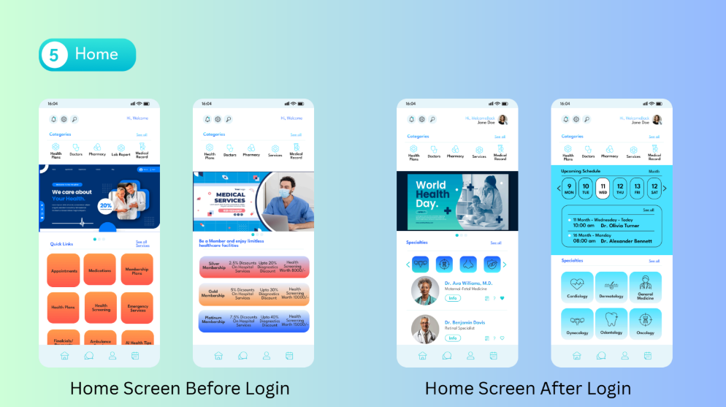
Products/Services
Fig 1: UI/UX Of Apnar Doctor

Slide 12
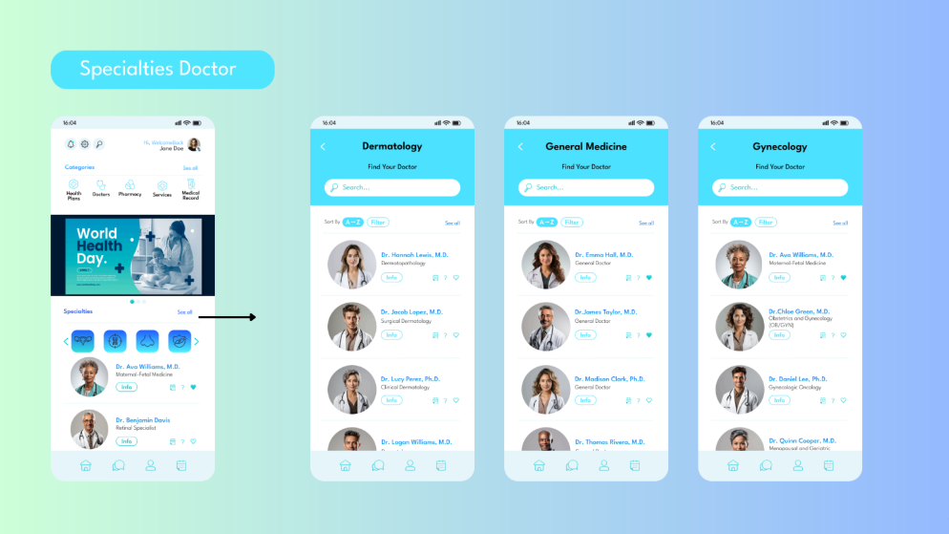
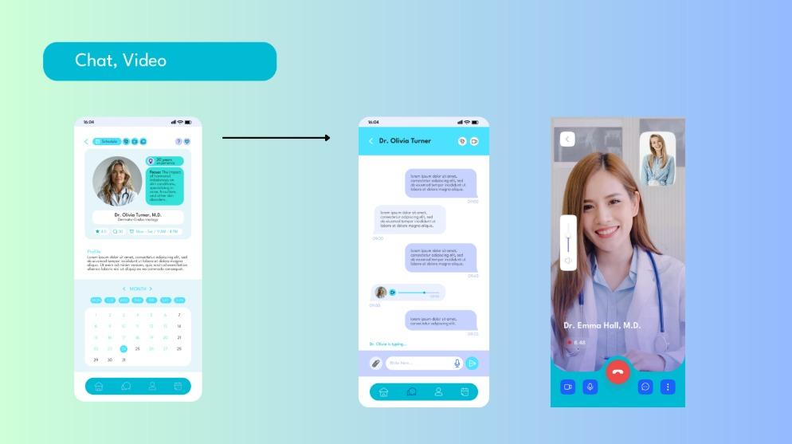
Products/Services
Fig 2: UI/UX Of Apnar Doctor

Slide 13
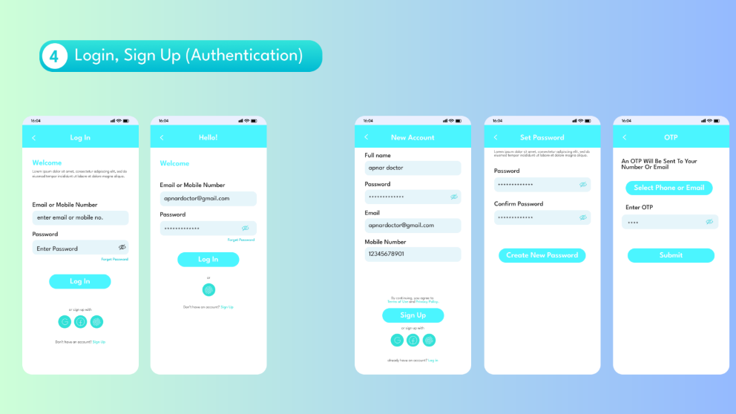
Products/Services
Fig 3: UI/UX Of Apnar Doctor

Slide 14

Products/Services
Fig 4: UI/UX Of Apnar Doctor

Slide 15
Specific Details on Training — Week-wise Activities
Week | Period | Key Activities
Week 1 | 01 April - 06 April | Project understanding and document review, requirement analysis and task breakdown, user roles and workflow identification
Week 2 | 07 April - 12 April | Private Git repository setup, database schema design, system architecture design, project structure planning and collaboration setup
Week 3 | 13 April - 20 April | UI/UX design creation, module architecture setup, UI/UX review and iteration, interface improvement and final adjustments

Slide 16
Specific Details on Training — Contribution
My Key Contributions:
Database— Built complete MySQL schema .
UI/UX Design—Make ui/ux design for Apnar Doctor project .
Documentation — Finalized technical report, GitHub README and defence presentation materials.

Slide 17
Acquired Skills During Industrial Training
Technical Skills
Backend API development
Database design (Prisma)
Validation using Zod
RESTful architecture
Professional Skills
Team communication
Requirement analysis
Problem-solving
Agile workflow understanding

Slide 18
PO-Skill Mapping
PO1: Engineering Knowledge → System Design
PO2: Problem Analysis → Requirement Analysis
PO3: Design Solutions → Architecture Planning
PO5: Modern Tools Usage → Prisma, Postman, Git
PO5: API Development → TypeScrip, NodeJs, ExpressJs

Slide 19
SDG–Goal Mapping
✅ Fully Fulfilled
SDG 4 Quality Education — Structured 3-week technical training in System Design , MySQL [1].
SDG 16 Peace, Justice & Strong Institutions — SQL security, ethical conduct & transparent documentation [2].
SDG 17 Partnerships for Goals — University-industry internship, team collaboration.
SDG 3 Good Health & Well-being — Maintained healthy work-life balance.
⚡ Partially Fulfilled
SDG 5 Gender Equality — App accessible to all investors regardless of gender.
❌ Not Fulfilled
SDG 2, 6, 7, 10,13, 14, 15 — Not relevant to software development internship scope.

Slide 20
Conclusion
Successfully completed initial phase (90 hours)
Gained real industry experience
Built strong foundation for full 6-month project
Ready to continue development at production level

Slide 21
Reference
[1] United Nations, "Transforming Our World: The 2030 Agenda for Sustainable Development," Resolution A/RES/70/1, 2015.
[2] IEEE, "IEEE Code of Ethics," IEEE Policies, Section 7, 2020. [Online]. Available: https://www.ieee.org/about/corporate/governance/p7-8.html.
[3]GeeksforGeeks. Introduction of ER model. Accessed: 2026-04-02.https://www.geeksforgeeks.org/dbms/ introduction-of-er-model/, 2026..

